Slide 1
虛擬化技術 Virtualization Technique
System Virtualization
CPU Virtualization

Slide 2
Agenda
Sensitive Instruction
What is Sensitive Instruction
Definition
Difference between sensitive instruction and privilege instruction
Virtualizable and Non-virtualizable
How to “trap-and-emulate”?
Introduction to “trap-and-emulate”
Para-Virtualization
Full-Virtualization
DBT
Hardware assistant
Vector Table
What is Vector Table
How to deliver interrupt in virtualized environment
Software solution
Hardware solution

Slide 3
Sensitive instruction
What is sensitive instruction?
How to “trap-and-emulate”?

Slide 4
Category of instructions
In architecture field, the CPU designers separate instructions into different categories.
Privilege instruction
Those instructions are trapped if the machine is in user mode and are not trapped if the machine is in kernel mode.
ex: Instruction to modify page table base register
Non-Privilege instruction
All other instructions
ex: Software interrupt, Normal arithmetic operation
In virtualization field, the hypervisor designers separate instructions into two categories.
Sensitive instruction
Those instructions that interact with hardware, which include control-sensitive and behavior-sensitive instructions.
ex: Instruction to modify page table base register, Software Interrupt, …
Non-sensitive instruction
All other instructions
ex: Normal arithmetic operation, …

Slide 5
Privilege instruction
In modern computer architecture, CPU contains privilege instructions and non-privilege instructions.
The OS designer use the privilege instructions and non-privilege instructions to separate between kernel space which access hardware resource directly and user space which access hardware resource indirectly.
HOWEVER, which instructions are privilege is decided by CPU designers, OS designer cannot change that.
If you execute privilege instruction in non-privilege mode, it will trigger an event and enter into the privilege mode.
This kind of behavior is also known as “trap”.

Slide 6
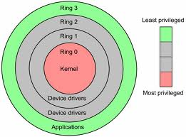
Privilege instruction
Take x86 architecture for example:
Kernel mode (Ring 0)
CPU may perform any operation allowed by its architecture, including any instruction execution, IO operation, area of memory access, and so on.
Traditional OS kernel runs in Ring 0 mode.
User mode (Ring 1 ~ 3)
CPU can typically only execute a subset of those available instructions in kernel mode.
Traditional application runs in Ring 3 mode.

Slide 7
Privilege instruction
Taking ARM architecture for another example:
Kernel mode (Privilege Level 1,a.k.a. PL1)
CPU may perform any operation allowed by its architecture, including any instruction execution, IO operation, area of memory access, and so on.
Traditional OS kernel runs in PL1.
User mode (PL0)
CPU can typically only execute a subset of those available instructions in kernel mode.
Traditional application runs in PL0 mode.
User Space
Kernel Space

Slide 8
Sensitive Instruction
Those instructions that interact with hardware, which include control-sensitive and behavior-sensitive instructions
Control sensitive instructions
Those that attempt to change the configuration of resources in the system.
Behavior sensitive instructions
Those whose behavior or result depends on the configuration of resources (the content of the relocation register or the processor's mode).

Slide 9
Example: ARMv6 ISA
Branch instructions
Data-processing instructions
Multiply instructions
Parallel addition and subtraction instructions
Extend instructions
Miscellaneous arithmetic instructions
Other miscellaneous instructions
Status register access instructions
Load and store instructions
Load and Store Multiple instructions
Semaphore instructions
Exception-generating instructions
Coprocessor instructions

Slide 10
Virtualizable CPU

Slide 11
Privilege and Non-Privilege
ps: whole circle is a set of all instructions
Non-Privilege
Privilege

Slide 12
Privilege and Sensitive
ps: whole circle is a set of all instructions
Non-Privilege
Privilege
Sensitive
All sensitive are privilege: Virtualizable CPU

Slide 13
Virtualizable CPU
All of sensitive instructions are privilege instructions.
We call this kind of CPU as “Virtualizable CPU”
For “Virtualizable CPU”, it is quite easy to implement hypervisor. All you have to do is to put hypervisor in privilege mode and Guest OS in non-privilege mode.
When Guest OS wants to execute sensitive instructions, the execution will be trapped to hypervisor which is running on privilege mode automatically.
By this way, we can make sure that there is no chance for Guest OS to change any important hardware resource directly. All important hardware resource is under management by hypervisor.

Slide 14
Virtualizable CPU
Example:
IBM PowerPC
IBM S/390
CPU for IBM mainframe

Slide 15
Non-Virtualizable CPU

Slide 16
Privilege and Sensitive
ps: whole circle is a set of all instructions
Non-Privilege
Privilege
Sensitive
Some sensitive are non-privilege: Non-Virtualizable CPU

Slide 17
Privilege and Sensitive
ps: whole circle is a set of all instructions
Non-Privilege
Privilege
Sensitive
Critical
Sensitive but Non-Privilege instruction is the problem.
We call “Sensitive but Non-Privilege instruction” as “Critical Instruction”.

Slide 18
Non-Virtualizable CPU
Some of sensitive instructions are privilege instructions. But some of sensitive instructions are non-privilege instructions.
We call this kind of CPU as “Non-Virtualizable CPU”
For “Non-Virtualizable CPU”, it is HARD to implement hypervisor.
If you put hypervisor in privilege mode and Guest OS in non-privilege mode, when Guest OS wants to execute sensitive instructions,
For those privilege and sensitive instructions, they (which is) will be trapped into hypervisor which is running on privilege mode automatically.
For those critical instructions, they will NOT be trapped into hypervisor automatically.

Slide 19
Critical instruction annoy us!
Critical instruction can be executed in privilege mode and non-privilege mode.
The behaviors of critical instructions in privilege mode and non-privilege mode are different. It will cause problems.
As a result, hypervisor designers have to let critical instructions be trapped to hypervisor, and let hypervisor emulate their behaviors.

Slide 20
Non-virtualizable CPU
Example:
x86
ARM

Slide 21
Sensitive instruction
What is sensitive instruction?
How to “trap and emulate”?

Slide 22
CPU Architecture
What is trap ?
When CPU is running in user mode, some internal or external events, which need to be handled in kernel mode, take place.
Then CPU will jump to hardware exception handler vector, and execute system operations in kernel mode.
Trap types :
System Call
Invoked by application in user mode.
For example, application ask OS for system IO.
Hardware Interrupts
Invoked by some hardware events in any mode.
For example, hardware clock timer trigger event.
Exception
Invoked when unexpected error or system malfunction occur.
For example, execute privilege instructions in user mode.

Slide 23
Trap and Emulate Model
If we want CPU virtualization to be efficient, how should we implement the VMM ?
We should make guest binaries run on CPU as fast as possible.
Theoretically speaking, if we can run all guest binaries natively, there will NO overhead at all.
But we cannot let guest OS handle everything, VMM should be able to control all hardware resources.
Solution :
Ring Compression
Shift traditional OS from kernel mode(Ring 0) to user mode(Ring 1), and run VMM in kernel mode.
Then VMM will be able to intercept all trapping event.

Slide 24
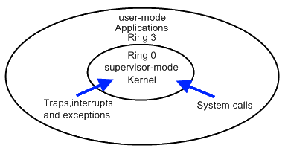
Trap and Emulate Model
VMM virtualization paradigm (trap and emulate) :
Let normal instructions of guest OS run directly on processor in user mode.
When executing privilege instructions, hardware will make processor trap into the VMM.
The VMM emulates the effect of the privilege instructions for the guest OS and return to guest.

Slide 25
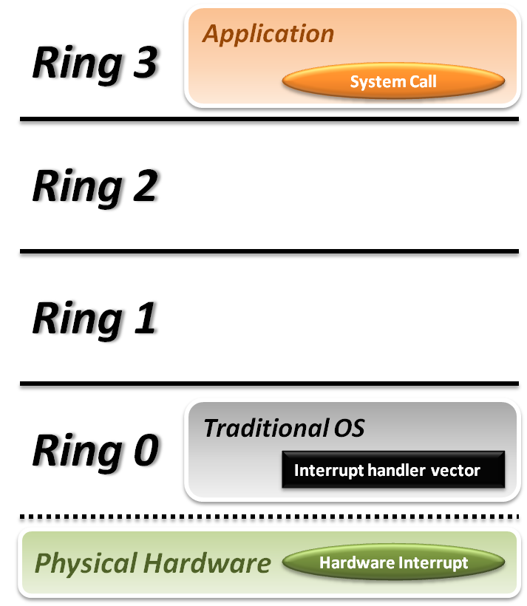


Trap and Emulate Model
Traditional OS :
When application invoke a system call :
CPU will trap to interrupt handler vector in OS.
CPU will switch to kernel mode (Ring 0) and execute OS instructions.
When hardware event :
Hardware will interrupt CPU execution, and jump to interrupt handler in OS.

Slide 26
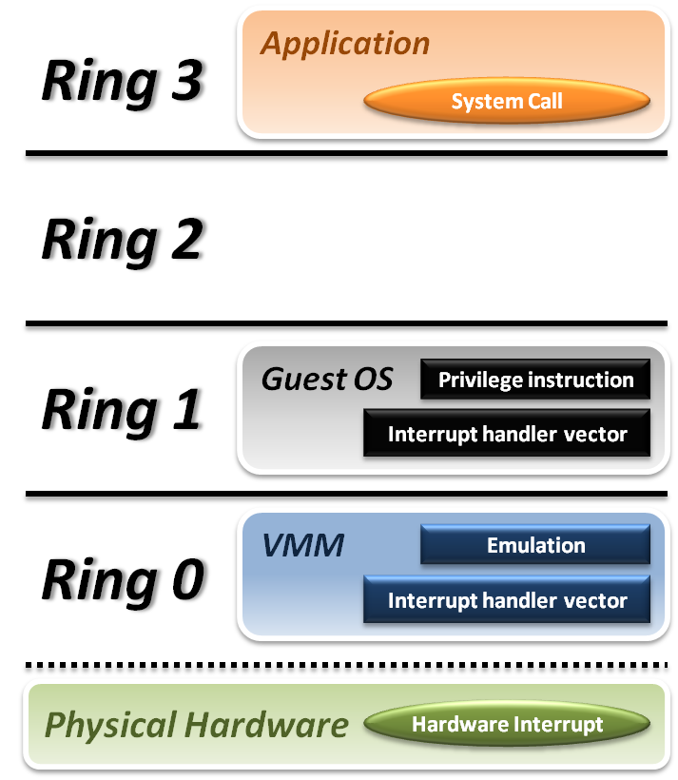






Trap and Emulate Model
VMM and Guest OS :
System Call
CPU will trap to interrupt handler vector of VMM.
VMM jump back into guest OS.
Hardware Interrupt
Hardware make CPU trap to interrupt handler of VMM.
VMM jump to corresponding interrupt handler of guest OS.
Privilege Instruction
Running privilege instructions in guest OS will be trapped to VMM for instruction emulation.
After emulation, VMM jump back to guest OS.

Slide 27
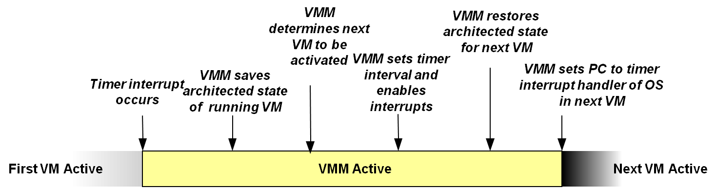
Context Switch
Steps of VMM switch different virtual machines :
Timer Interrupt occurs in running VM.
Context switch to VMM.
VMM saves state of running VM.
VMM determines next VM to execute.
VMM sets timer interrupt.
VMM restores state of next VM.
VMM sets PC to timer interrupt handler of next VM.
Next VM active.

Slide 28
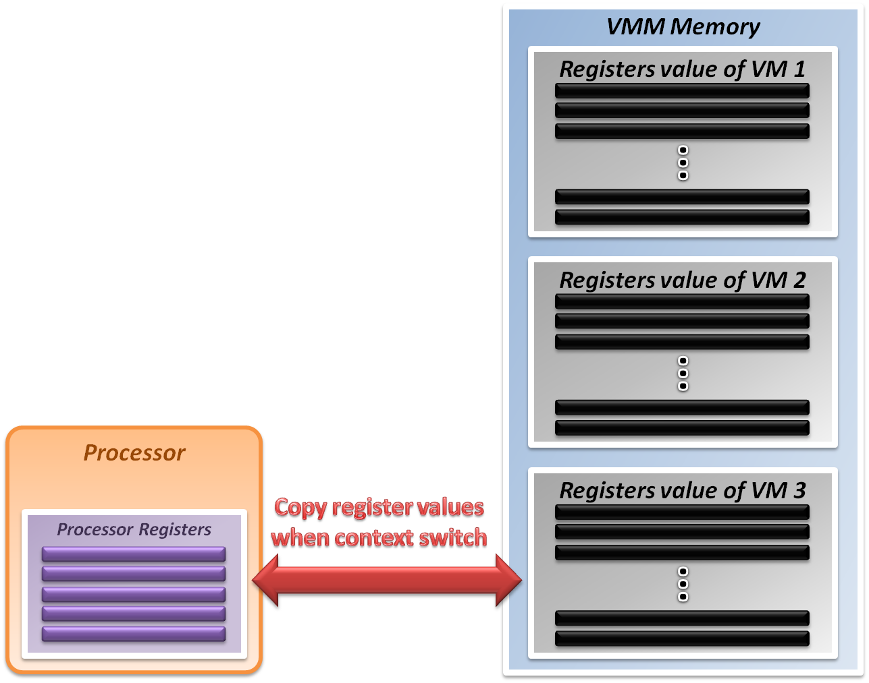
System State Management
Virtualizing system state :
VMM will hold the system states of all virtual machines in memory.
When VMM context switch from one virtual machine to another
Write the register values back to memory
Copy the register values of next guest OS to CPU registers.

Slide 29
Virtualization Theorem
Subset theorem :
For any conventional third-generation computer, a VMM may be constructed if the set of sensitive instructions for that computer is a subset of the set of privileged instructions.
Recursive Emulation :
A conventional third-generation computer is recursively virtualizable if
It is virtualizable
VMM without any timing dependencies can be constructed for it.
Under this theorem, x86 or ARM architecture cannot be virtualized directly. Other techniques are needed.

Slide 30
Virtualization Techniques
How to virtualize non-virtualizable hardware :
Para-virtualization
Modify guest OS to skip the critical instructions.
Implement some hyper-calls to trap guest OS to VMM.
Binary translation
Use emulation technique to make hardware virtualizable.
Skip the critical instructions by means of these translations.
Hardware assistance
Modify or enhance ISA of hardware to provide virtualizable architecture.
Reduce the complexity of VMM implementation.

Slide 31
Para-Virtualization:
Patch Guest OS

Slide 32
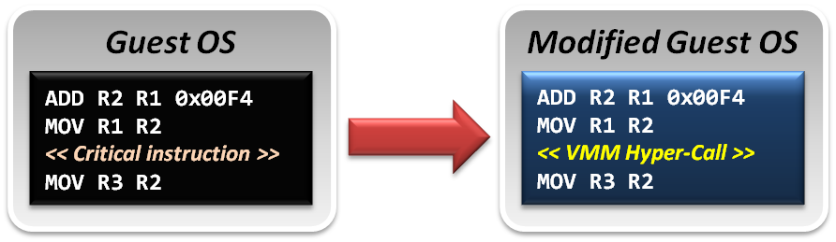
Para-Virtualization
Para-Virtualization implementation :
In para-virtualization technique, guest OS should be modified to prevent invoking critical instructions.
Instead of knowing nothing about hypervisor, guest OS will be aware of the existence of VMM, and collaborate with VMM smoothly.
VMM will provide the hyper-call interfaces, which will be the communication channel between guest and host.

Slide 33
Example of Para-virtualization
.macro virt_svc_movs, inst
SWI 0x190
\inst
.endm
…
mov r0, r0
add sp, sp
movs pc, lr
…
…
mov r0, r0
add sp, sp
virt_svc_movs “movs pc, lr”
…
We replace the instruction by a self-defined macro. The original instruction is the parameter of the macro. This macro would send a software interrupt to VMM. When receiving the SWI number 0x190, VMM has the knowledge that the next instruction is a instruction which should be emulated.
Notes:
We replace the instruction with a self-defined macro. The original instruction is the parameter of the macro. This macro would send a software interrupt to VMM. When receiving the SWI number 0x190, VMM has the knowledge that the next instruction is a instruction which should be emulated.

Slide 34
Some Difficulties
Difficulty of para-virtualization :
Guest OS modification
User should at least has the source code of guest OS; otherwise, para-virtualization cannot be used.

Slide 35
Full-Virtualization:
Dynamic Binary Translation

Slide 36
Binary Translation
In emulation techniques :
Binary translation module is used to optimize binary code blocks, and translates binaries from guest ISA to host ISA.
In virtualization techniques :
Binary translation module is used to skip or modify the guest OS binary code blocks which include critical instructions.
Translate those critical instructions into some privilege instructions which will be trapped to VMM for further emulation.

Slide 37
Binary Translation (revisited)
Static approach vs. Dynamic approach :
Static binary translation
The entire executable file is translated into an executable of the target architecture.
This is very difficult to do correctly, since not all the code can be discovered by the translator.
Dynamic binary translation
Looks at a short sequence of code, typically on the order of a single basic block, translates it and caches the resulting sequence.
Code is only translated as it is discovered and when possible, branch instructions are made to point to already translated and saved code.

Slide 38
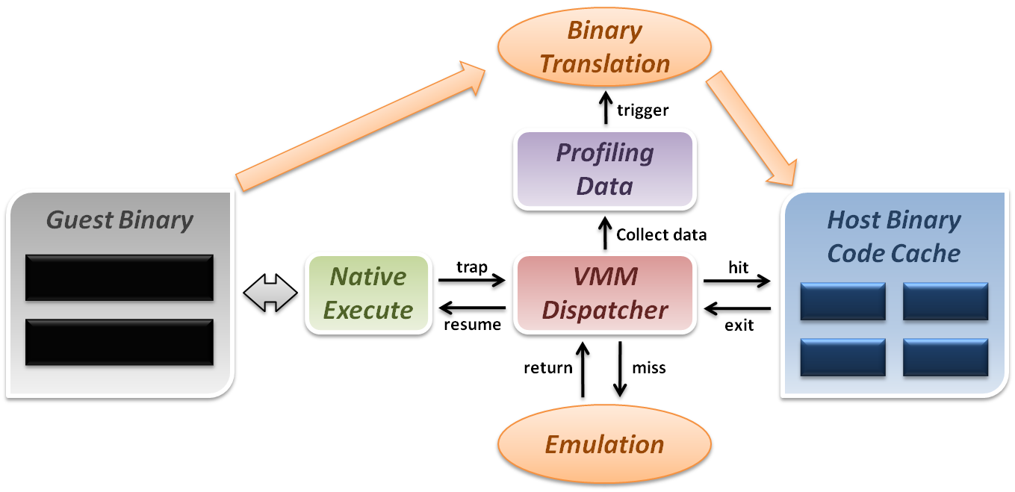
Dynamic Binary Translation (revisited)
Dynamic binary translation and optimization
VMM can dynamically translate binary code and collect profiling data for further optimization.

Slide 39
Some Difficulties
Difficulties of binary translation :
Self-modifying code
If guest OS will modify its own binary code in runtime, binary translation needs to flush the corresponding code cache and retranslates the code block.
Self-reference code
If guest code needs to read its own binary code in runtime, VMM needs to make the referring back to original guest binaries location.
Real-time system
For some timing critical guest OS, emulation environment will lose precise timing, and this problem cannot be perfectly solved yet.

Slide 40
Full-Virtualization:
Hardware Assistant

Slide 41
Hardware Solution
Why are there so many problems and difficulties ?
Critical instructions do not trap in user mode.
Even we make those critical instructions trap, their semantic may also be changed; which is not acceptable.
In short, legacy processors did not design for virtualization purpose at the beginning.
If processor can be aware of the different behaviors between guest and host, the VMM design will be more efficient and simple.

Slide 42
Hardware Solution
Let’s go back to trap model :
Some trap types do not need the VMM involvement.
For example, all system calls invoked by applications in Guest OS should be caught by Guest OS only. There is no need to trap to VMM and then forward it back to guest OS, which will introduce context switch overhead.
Some critical instructions should not be executed by guest OS.
Although we make those critical instructions trap to VMM, VMM cannot identify whether this trapping action is caused by the emulation purpose or the real OS execution exception.
Solution :
We need to redefine the semantic of some instructions.
We need to introduce new CPU control paradigm.

Slide 43
Intel VT-x
In order to straighten those problems out, Intel introduces one more operation mode of x86 architecture.
VMX Root Operation (Root Mode)
All instructions in this mode are no different to traditional ones.
All legacy software can run in this mode correctly.
VMM should run in this mode and control all system resources.
VMX Non-Root Operation (Non-Root Mode)
All sensitive instructions in this mode are redefined.
The sensitive instructions will trap to Root Mode.
Guest OS should run in this mode and be fully virtualized through typical “trap and emulation model”.

Slide 44
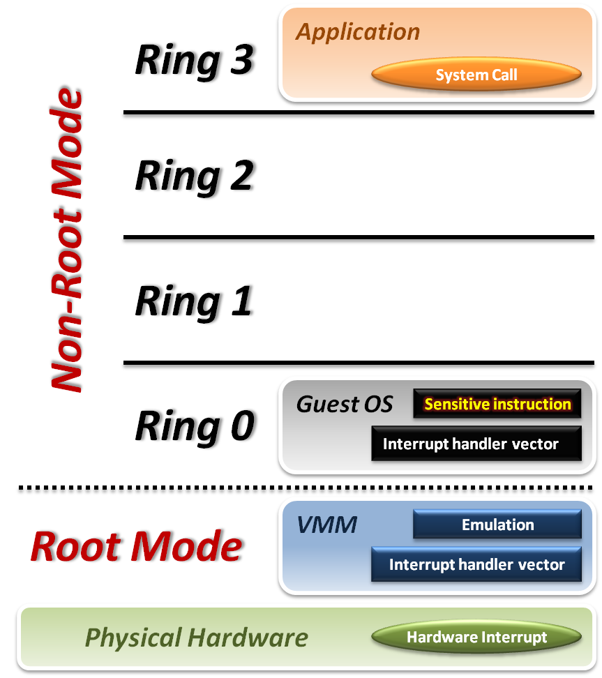





Intel VT-x
VMM with VT-x :
System Call
CPU will directly trap to interrupt handler vector of guest OS.
Hardware Interrupt
Still, hardware events need to be handled by VMM first.
Sensitive Instruction
Instead of trap all privilege instructions, running guest OS in Non-root mode will trap sensitive instruction only.

Slide 45
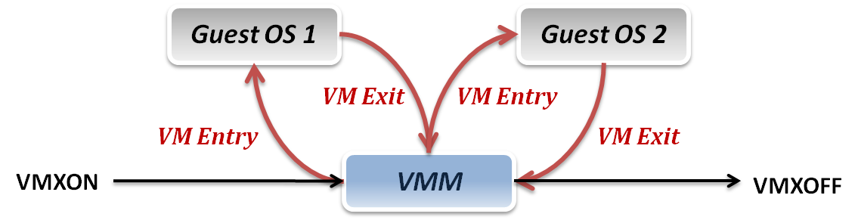
Context Switch
VMM switches different virtual machines with Intel VT-x :
VMXON/VMXOFF
These two instructions are used to turn on/off CPU Root Mode.
VM Entry
This is usually caused by the execution of VMLAUNCH/VMRESUME instructions, which will switch CPU mode from Root Mode to Non-Root Mode.
VM Exit
This may be caused by many reasons, such as hardware interrupts or sensitive instruction executions.
Switch CPU mode from Non-Root Mode to Root Mode.

Slide 46
System State Management
Intel introduces a more efficient hardware approach for register switching, VMCS (Virtual Machine Control Structure) :
State Area
Store Host OS system state when VM-Entry.
Store Guest OS system state when VM-Exit.
Control Area
Control instruction behaviors in Non-Root Mode.
Control VM-Entry and VM-Exit process.
Exit Information
Provide the VM-Exit reason and some hardware information.
Whenever VM Entry or VM Exit occur, CPU will automatically read or write corresponding information into VMCS.

Slide 47
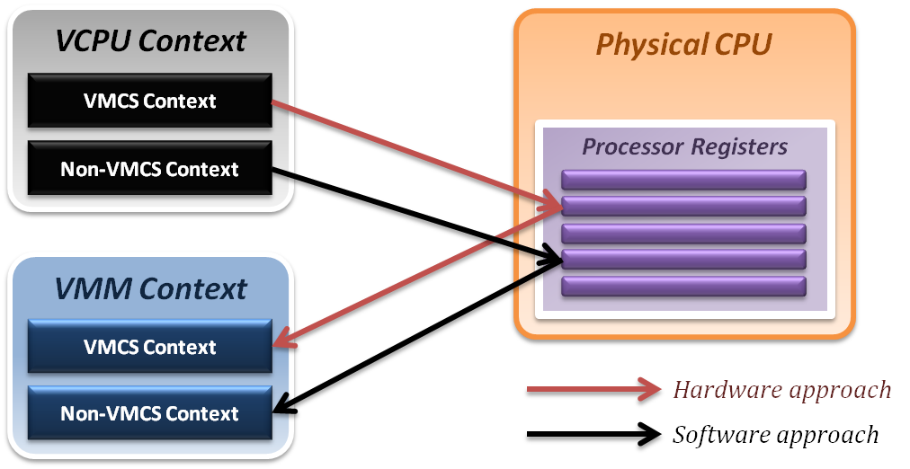
System State Management
Binding virtual machine to virtual CPU
VCPU (Virtual CPU) contains two parts
VMCS maintains virtual system states, which are handled by hardware.
Non-VMCS maintains other non-essential system information, which is handled by software.
VMM needs to handle Non-VMCS part.

Slide 48
Vector table
What is vector table?
How to deliver interrupt in virtualized environment?

Slide 49
Interrupt and Vector
In modern computer system, the CPU uses vector table which is saved in memory to handle the interrupt events.
CPU provides a vector base address to save the vector which contains lots of interrupt event handlers.
Different kinds of interrupts will route to different vector stubs by hardware.
OS will set related vector event handlers in the vector to handle the related events.
Interrupt events can be triggered by hardware or software.

Slide 50
Vector table
How to separate different interrupts into different kinds is architecture depend.
In following slides, we take ARM architecture for example.
Here is the vector table of ARM architecture.
Vector offset | Which kind of event will route to here
0x1C | Fast Interrupt Request
0x18 | Interrupt Request
0x14 | (Reserved, Not used)
0x10 | Data Abort
0x0C | Prefetch Abort
0x08 | Supervisor Call
0x04 | Undefined Instruction
0x00 | Reset

Slide 51
Vector table
Vector table can be set in high-bit of memory address or low-bit of memory address. Most of time, OS will set it on high-bit of memory address because high-bit of memory address is for kernel space.
OS will set related interrupt event handlers to handle interrupt requests.

Slide 52
Vector table
Assume that base address of vector table is 0xFFFF0000
ps: “b reset_handler” is a assembly code which means “branch to the reset_handler label”
Virtual Memory Address | Content of memory
0xFFFF0000 + 0x1C | b fiq_handler
0xFFFF0000 + 0x18 | b irq_handler
0xFFFF0000 + 0x14 | .
0xFFFF0000 + 0x10 | b dabort_handler
0xFFFF0000 + 0x0C | b pabort_handler
0xFFFF0000 + 0x08 | b svc_handler
0xFFFF0000 + 0x04 | b undef_handler
0xFFFF0000 + 0x00 | b reset_handler

Slide 53
Software interrupt

Slide 54
Virtual Memory Address
CPU mode:
Supervisor Mode
svc_handler:
…
Kernel
Space
+ 0x1C | b fiq_handler
+ 0x18 | b irq_handler
+ 0x14 | .
+ 0x10 | b dabort_handler
+ 0x0C | b pabort_handler
+ 0x08 | b svc_handler
+ 0x04 | b undef_handler
+ 0x00 | b reset_handler
Vector
Table
0xFFFF0000
User
Space
CPU mode:
User Mode
…
svc #0x190
…
PC

Slide 55
Hardware Interrupt

Slide 56
Virtual Memory Address
CPU mode:
Supervisor Mode
irq_handler:
…
Kernel
Space
“IRQ”
Interrupt from hardware
+ 0x1C | b fiq_handler
+ 0x18 | b irq_handler
+ 0x14 | .
+ 0x10 | b dabort_handler
+ 0x0C | b pabort_handler
+ 0x08 | b svc_handler
+ 0x04 | b undef_handler
+ 0x00 | b reset_handler
Vector
Table
0xFFFF0000
User
Space
CPU mode:
User Mode
…
…
…
PC

Slide 57
Vector table
What is vector table?
How to deliver interrupt in virtualized environment?

Slide 58
How to deliver interrupt in virtualized environment?
Because in virtualized environment, we cannot let Guest OS access hardware resource directly.
As a result, all of interrupts have to route to hypervisor’s vector table.
In type-1 VMM, we set original vector table for hypervisor and let hypervisor control all interrupts. That’s all!
However, for type-2 VMM, it is quite hard to implement since host OS still needs to directly control hardware resource. So we cannot direct replace OS’s vector table to hypervisor’s vector table.

Slide 59
Software Solution

Slide 60
Software solution
In software solution, we can duplicate the original vector table and save original vector table to another memory address.
Then, replace the original vector table which is used for host OS to the vector table used for hypervisor.
When interrupt occurs, it will be routed to the vector table of hypervisor (because there is only one vector table for CPU)
Only the interrupt which should be handle by hypervisor will route to the hypervisor trap interface. Otherwise, other interrupts will route to original interrupt handler.

Slide 61
Vector
0x1C | FIQ
0x18 | IRQ
0x14 | (Reserved)
0x10 | Data Abort
0x0C | Prefetch Abort
0x08 | Supervisor Call
0x04 | Undef. Instr.
0x00 | Reset
oxffff1000
0xffff001c
Kernel Vector
oxffff0000
Notes:
有一個exception vector table在一班的OS裡面，用來重新導向不同的trap到相對應的處理者

Slide 62
KVM Vector
The KVM trap
Interface
oxffff1000
0xffff001c
KVM
Vector
oxffff0000
Notes:
We imitate this mechanism. We design a KVM vector, and the KVM vector would re-direct traps to the KVM trap interface which is placed at address 0xffff1000 in another shared page. The exception trap to this vector would be re-direct to the interface for later handling.

Slide 63
Hardware Assistant Solution

Slide 64
Hardware assistant
In software solution, we can see that there is only one vector table for CPU. As a result, even some interrupts can be directly routed to guest OS, it still needs to route to hypervisor’s vector table first.
In hardware assistant environment, hardware provides more than one vector tables which are saved in related vector table base address register
That is to say, there are more than one vector tables for CPU. So, if an interrupt is allowed to route to Guest OS directly, it will be routed to the vector table of Guest OS rather than the vector table of hypervisor.
Only the interrupts which hypervisor really cares, the interrupts will route to the vector table of hypervisor.

Slide 65
Vector in ARM architecture (partial)
Non-Secure State
Guest User Space
VT for Non-Secure PL0&1
Host OS
Hypervisor
VT for Hyp mode
ARM Cortex-A15 and beyond

Slide 66
References
Books :
James E. Smith & Ravi Nair, Virtual Machines, Elsevier Inc., 2005
英特爾開源軟件技術中心 & 復旦大學並行處理研究所, 系統虛擬化 – 原理與實現, 北京 : 清華大學出版社, 2009.03
Paper resources :
Jiun-Hung Ding, Chang-Jung Lin, Ping-Hao Chang, Chieh-Hao Tsang, Wei-Chung Hsu, Yeh-Ching Chung, "ARMvisor: System Virtualization for ARM", Linux Symposium
Architecture manual resource:
“ ARM® Architecture Reference Manual ARMv7-A and ARMv7-R edition”, ARM Limited.
Other resources :
Lecture slides of “Virtual Machine” course (5200) in NCTU
Lecture slides of “Cloud Computing” course (CS5421) in NTHU

